Slide 1

Rocket travel
Bus company management web application
Developed by: Anghel Paul David
Boboc Razvan Marius
Lascau Ionut Sebastian

Slide 2
Content
Project overview
Application roles & functionalities
- Guest
- User
- Admin
Conclusion

Slide 3
Project overview i
The scope of this website is to motivate and attract customers of all backgrounds wishing for an easy-to-access bus ticket booking system, that they can access from the comfort of their homes, by providing sufficient and appropriate information about the available routes/trips.
The project is destined in such a way so that users get a valuable user experience when using it. For this, a simple layout and design was thought beforehand so that users can navigate the website intuitively and productively.

Slide 4
Project overview ii
This web application serves as an incentive to drive more traffic to the public transportation market by convincing more and more people to book their tickets online, from the comfort of their homes.
Therefore, several layouts were built in order to achieve this.

Slide 5
Guest
A guest can freely view the web application and check out the information about bus trips and announcements.
If you are not logged in yet, you are a guest on the web page.

Slide 6
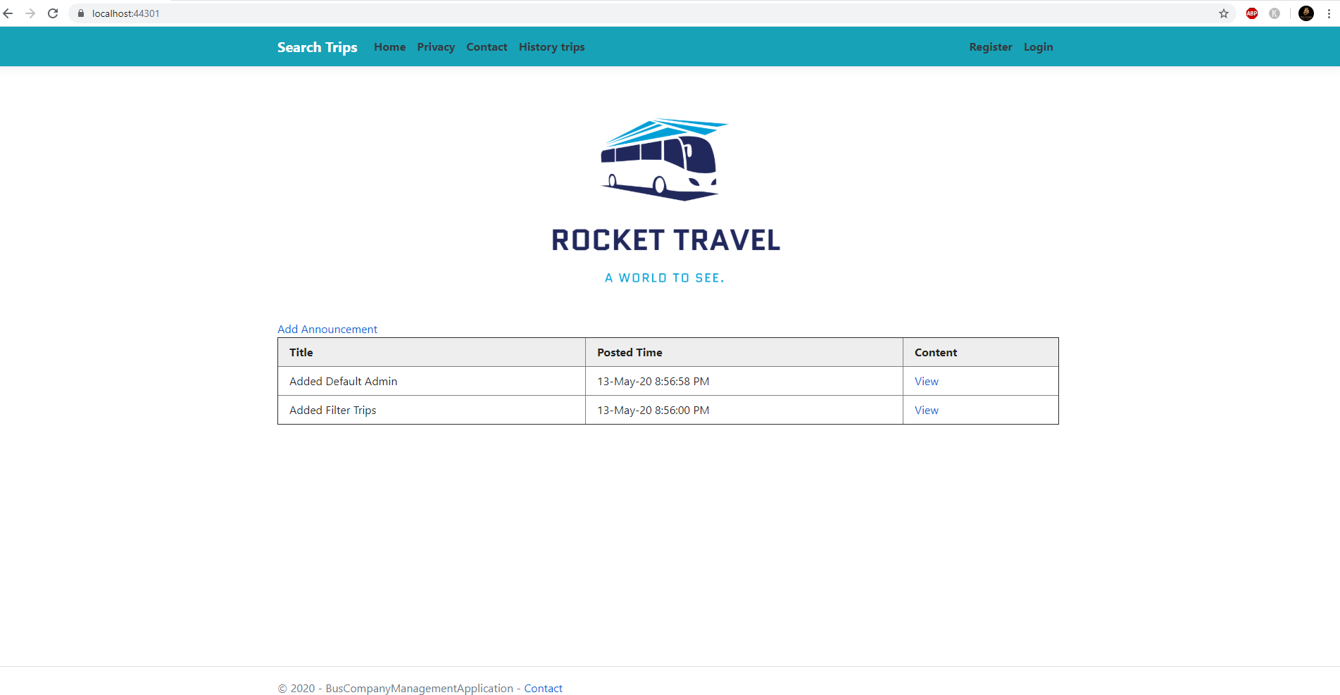
The Guest role is active

Slide 7
Home page
The guest can access the content of an announcement by clicking the “View” button from the content column

Slide 8
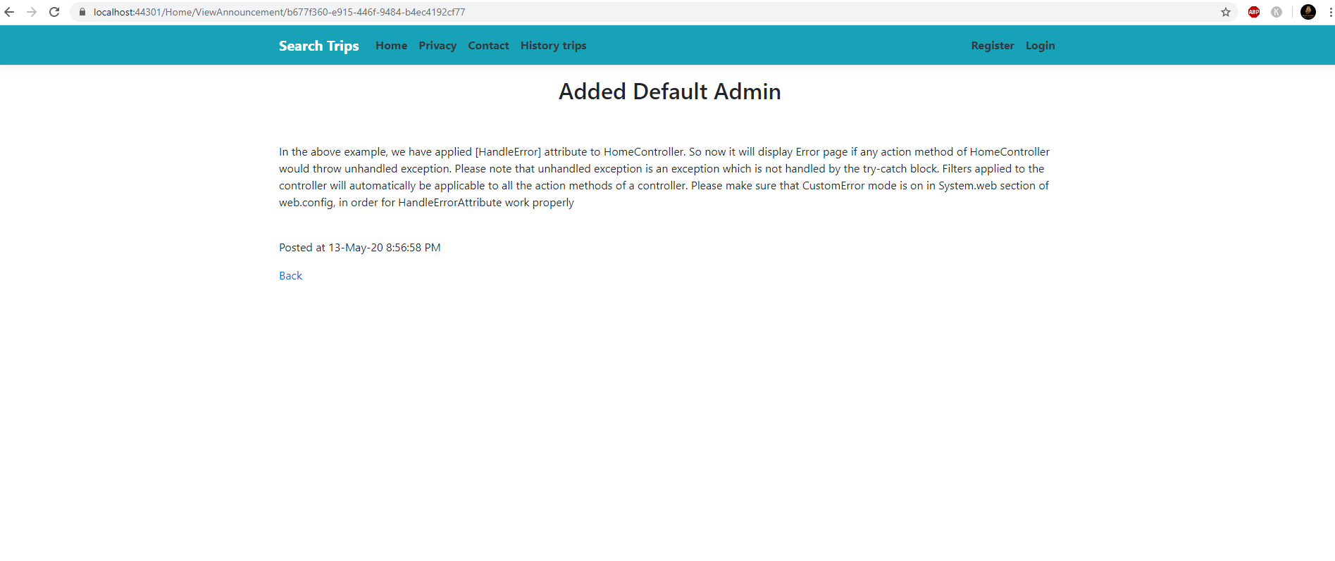
The content of the announcement is displayed, also the posted date and time
(This is an example of content)

Slide 9
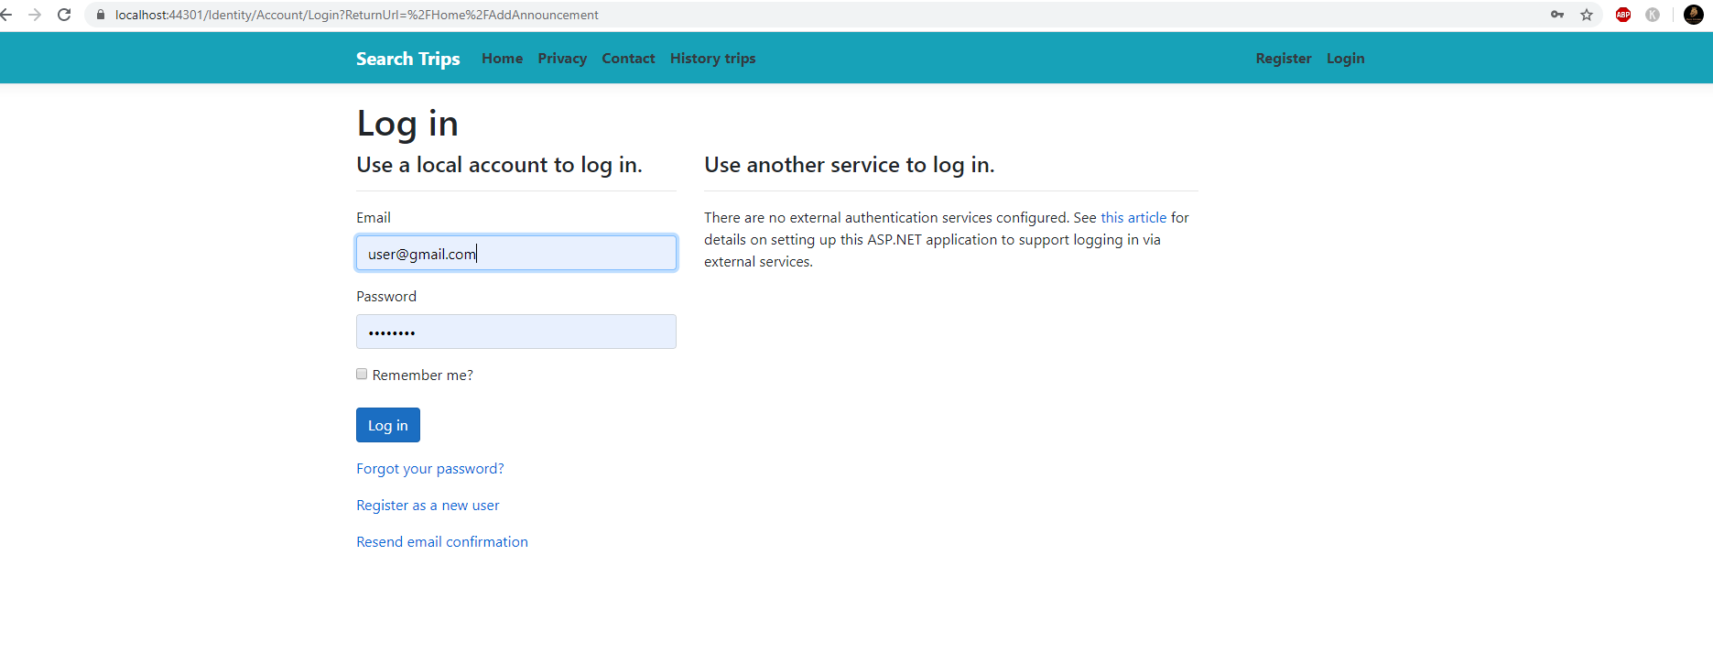
If the Guest try to access the “Add Announcement” button from the Home page he will be redirected to the Login page because he has no rights to add an anouncement

Slide 10
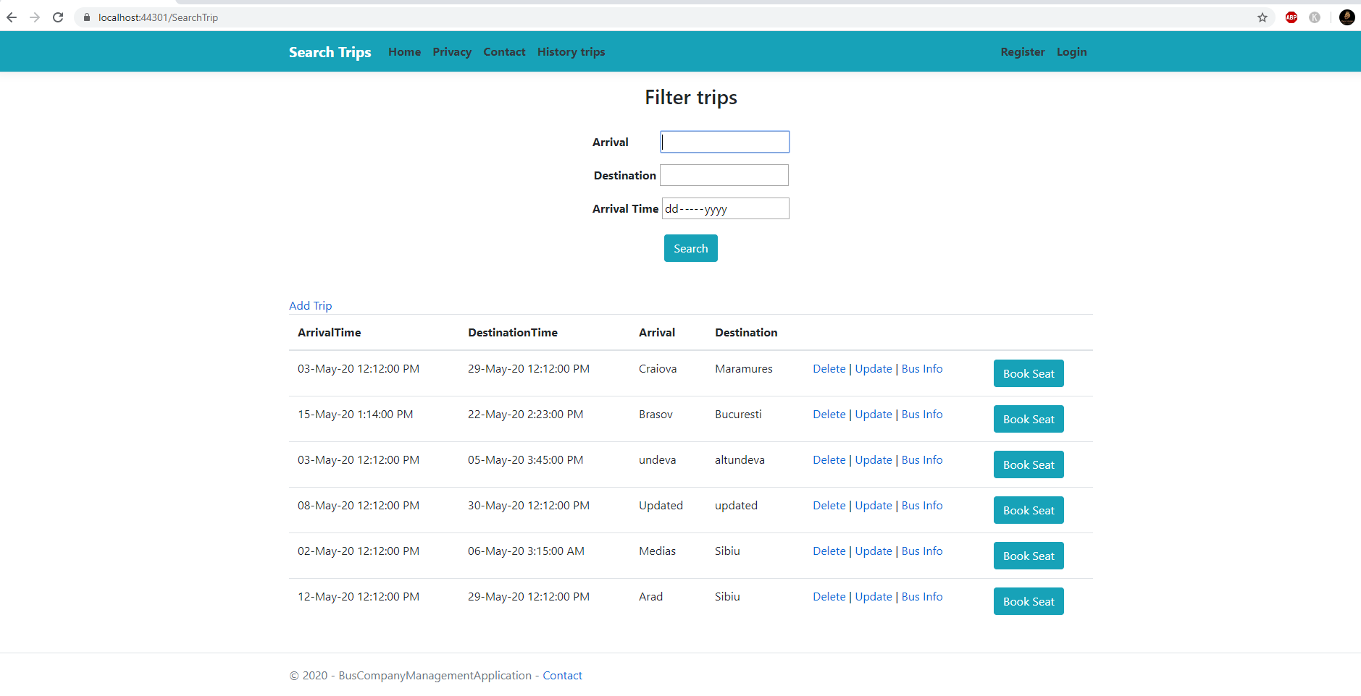
The Guest can access the “Search Trips” tab, filter the trips and also to see the bus on the specific route by clicking the “Bus Info” button

Slide 11
The Guest can’t book a seat, delete, update, or add a trip!

Slide 12
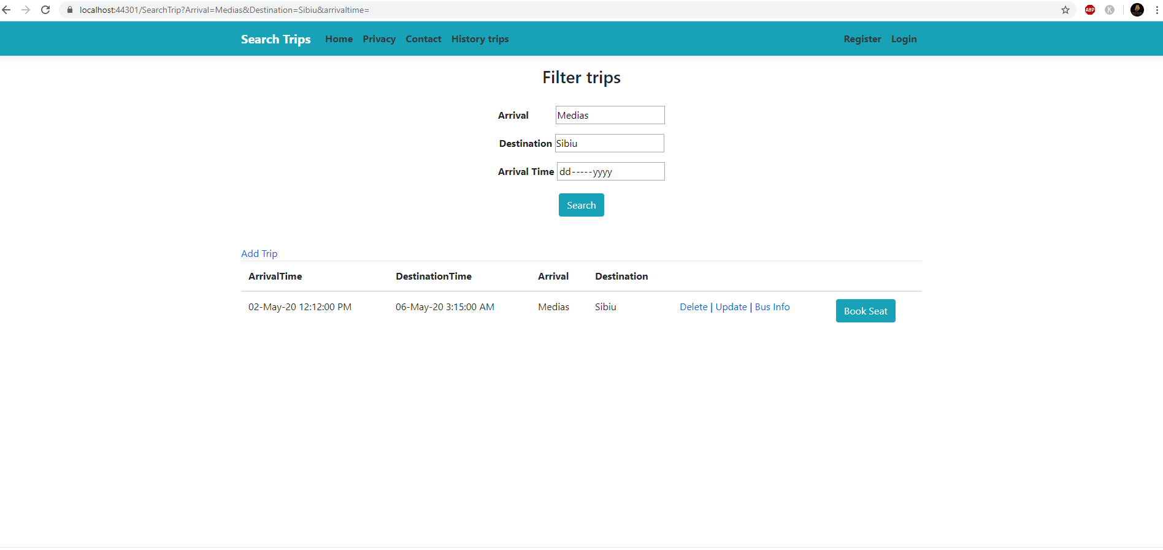
The filter on trips can be applied using 3 filters: Arrival, Destination and Arrival Time
In the screenshot it can be seen a filtering example result

Slide 13
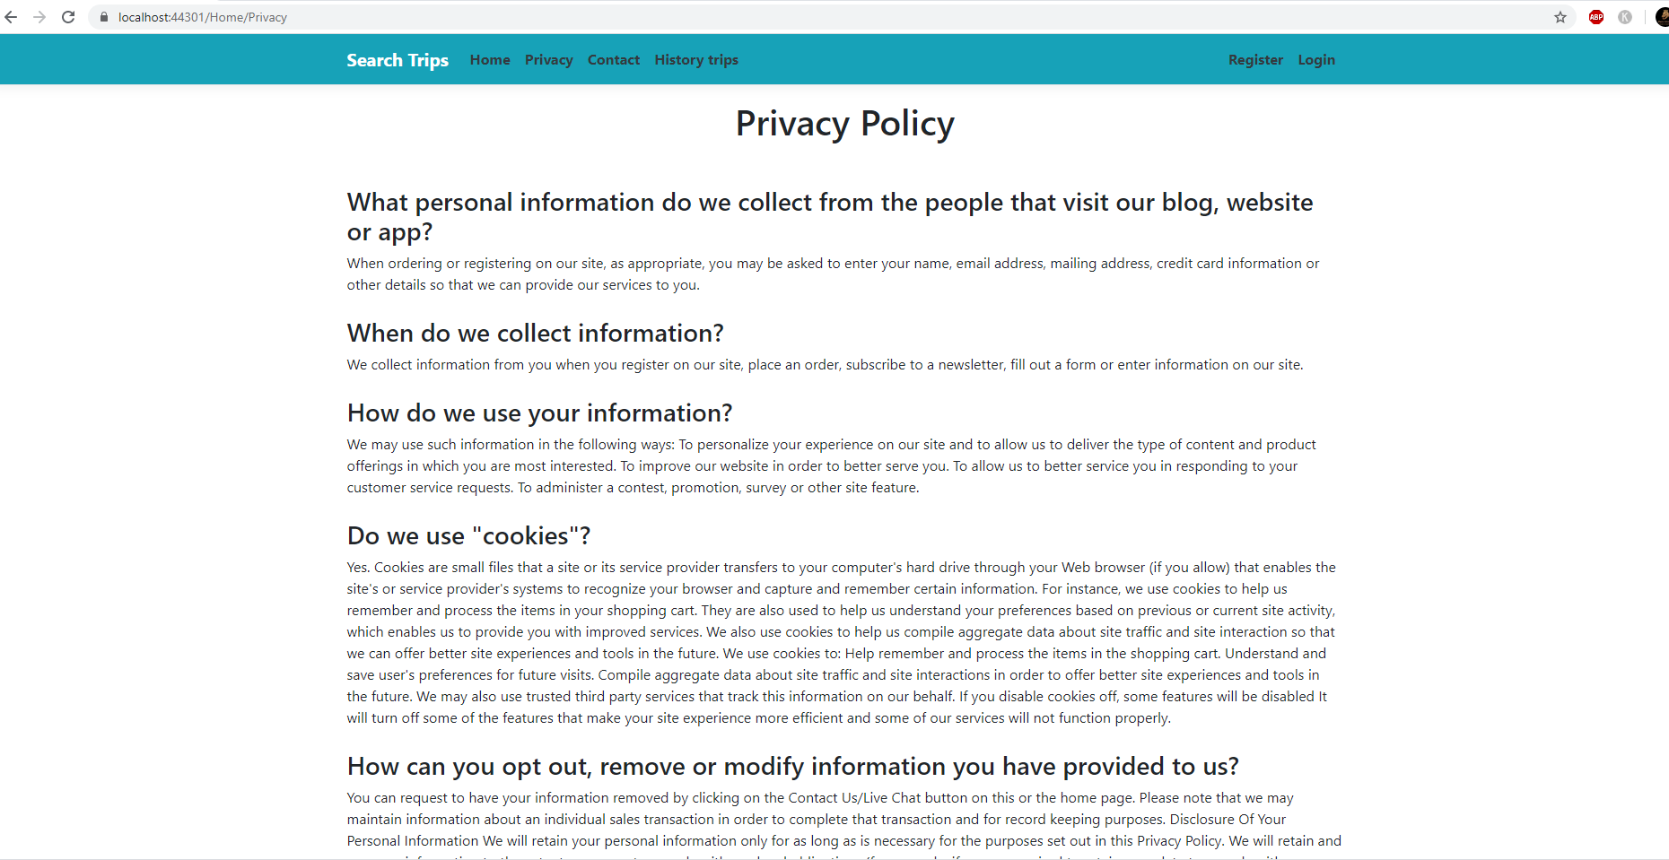
The Guest can access the Privacy page.

Slide 14
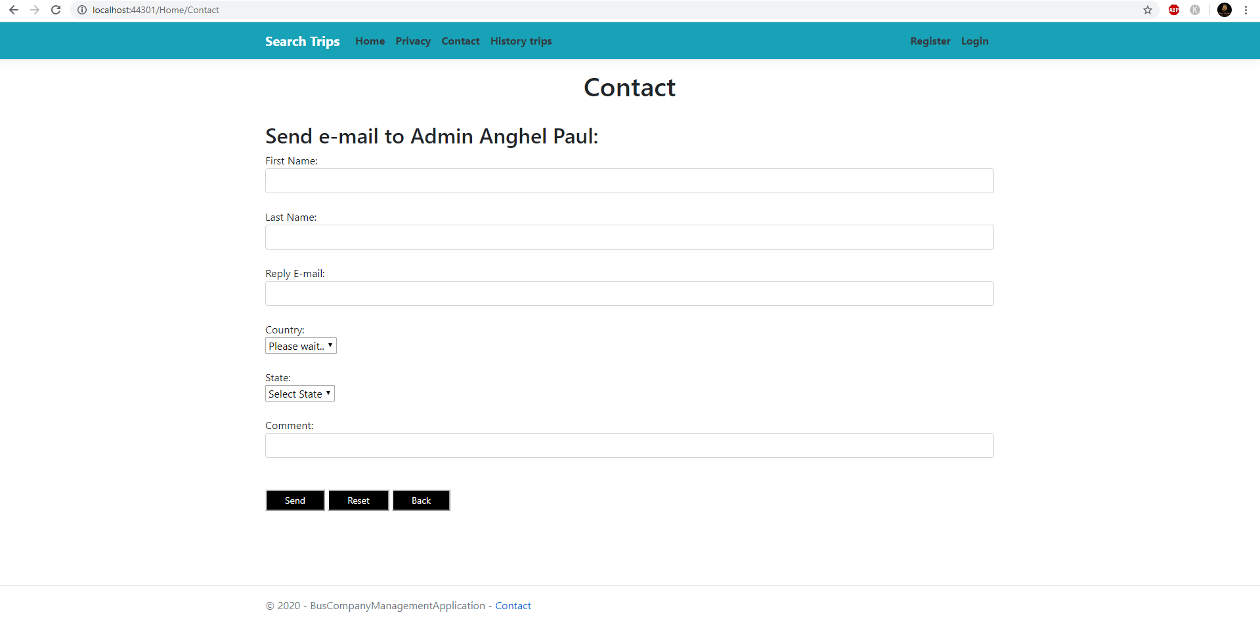
- The Guest can access also the contact page to send an E-mail to the admin regarding the application
The Guest must provide a First name, last name, and E-mail where he will receive the feedback from admin
Also the country that is automatically selected using the user IP
The state must be selected manually from the dropmenu
A comment/feedback box that will be send to the admin.

Slide 15
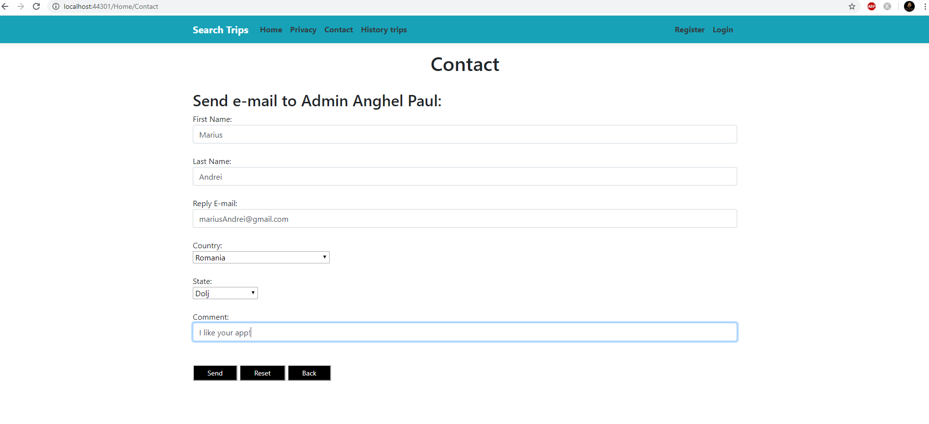

Slide 16
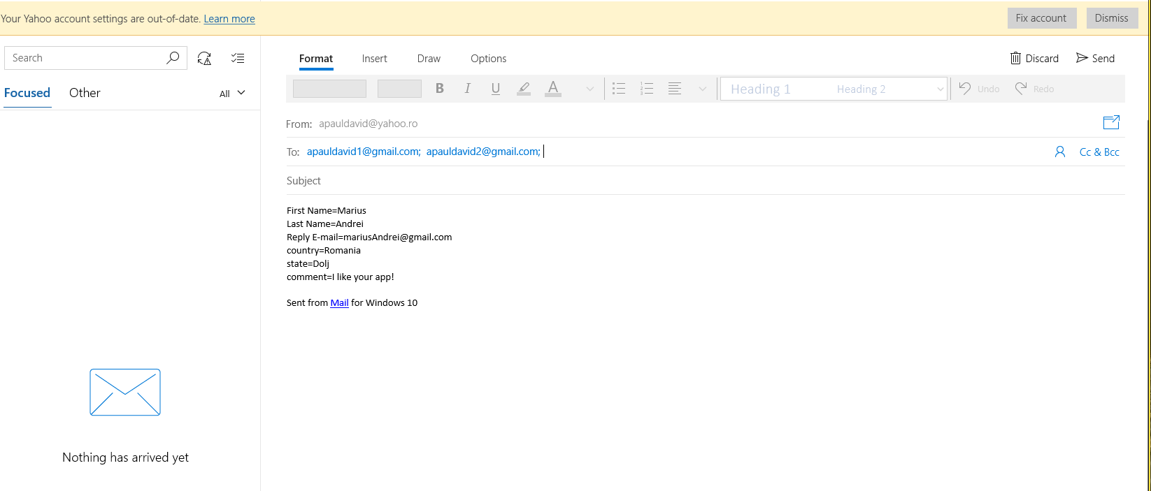
The E-mail app will be automatically opened containing the details given in the Contact form, and after the sent button will be clicked the E-mail will be sent to the default admins E-mails.

Slide 17
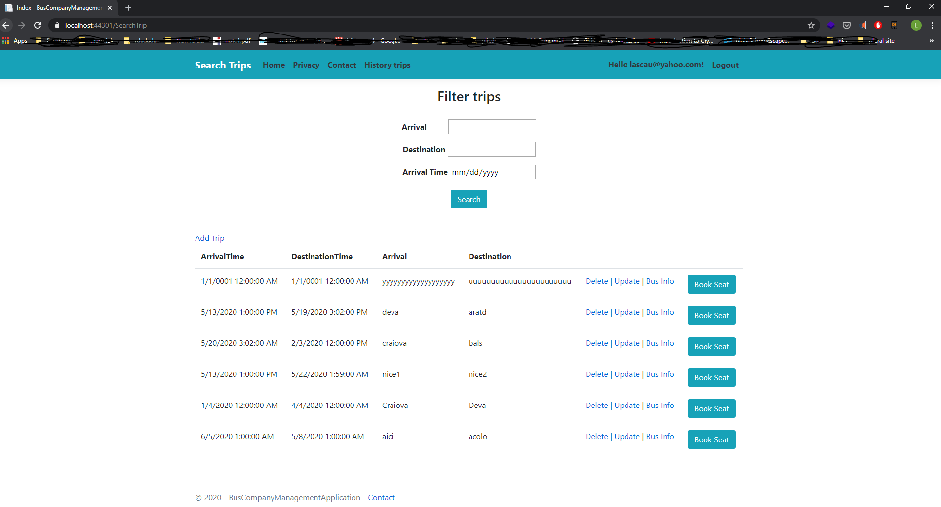
User search trip page

Slide 18
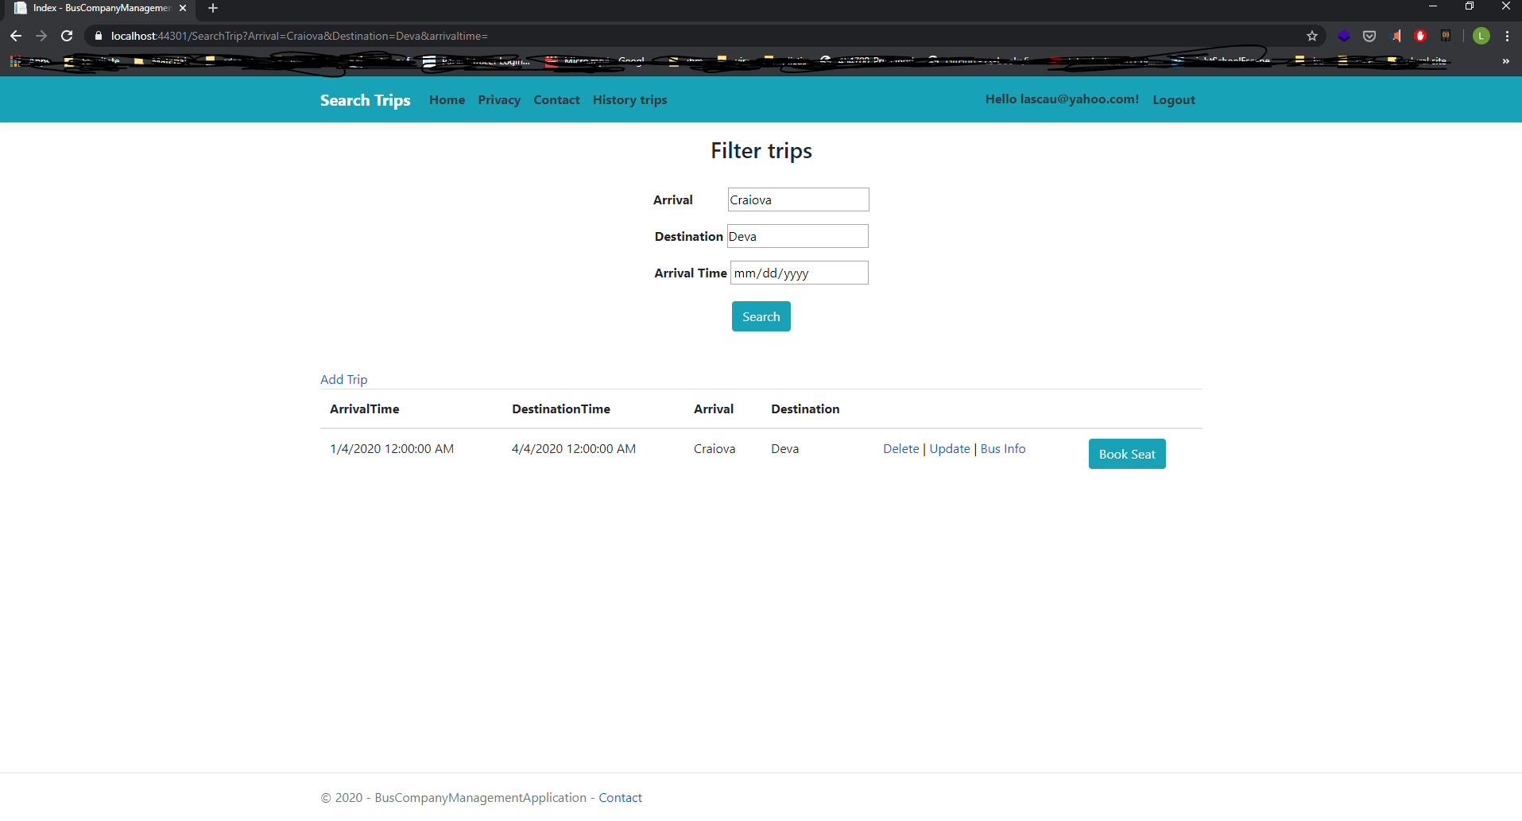
What a user can do?
He can search trips by arrival, destination and Arrival time

Slide 19
The user can access the bus info on the specified route

Slide 20
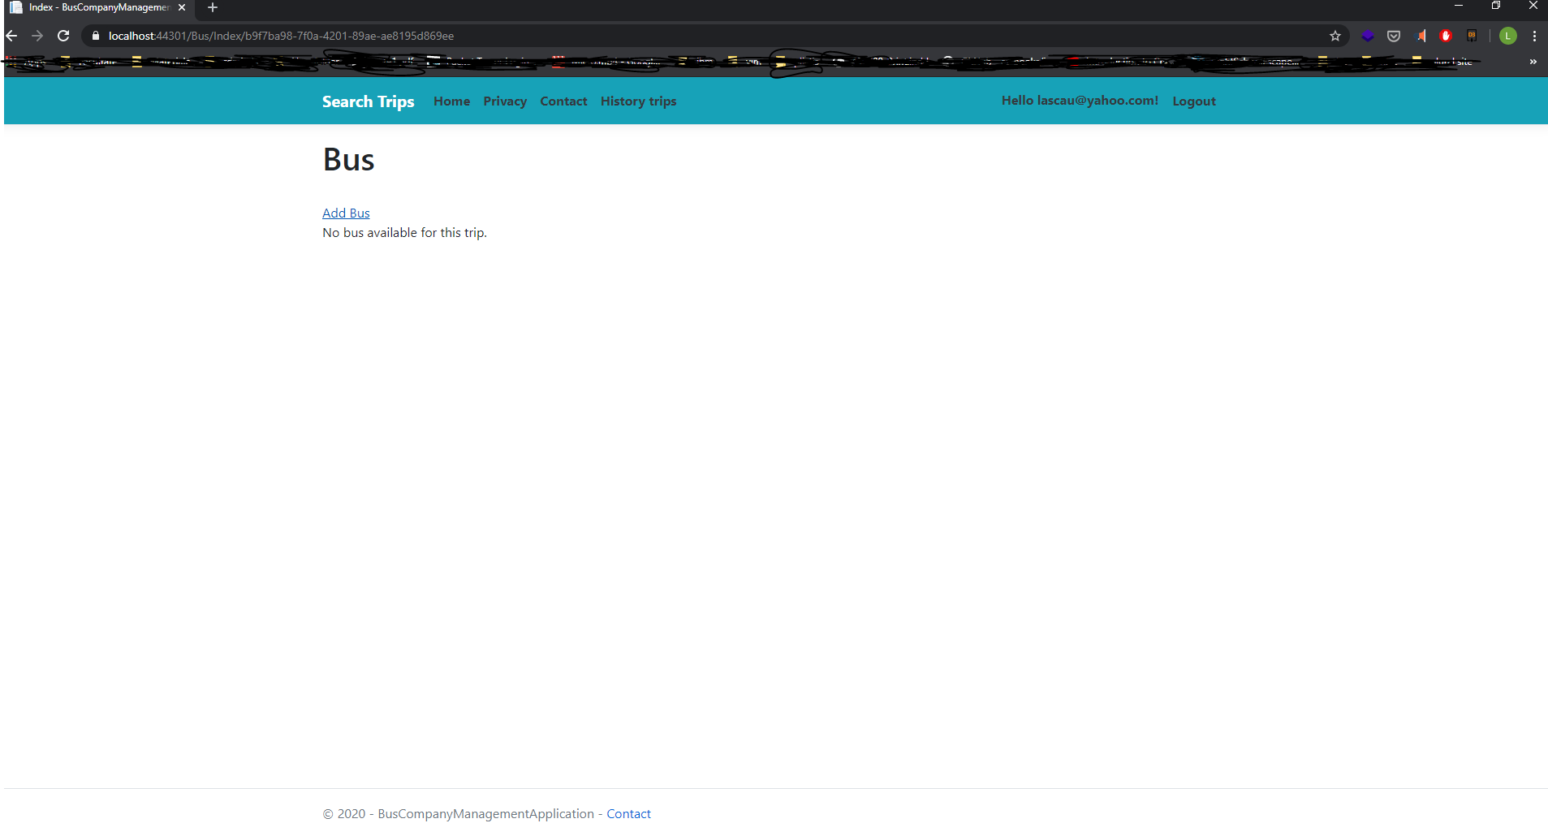
If there is not a bus on the specified route, a proper message will be displayed

Slide 21
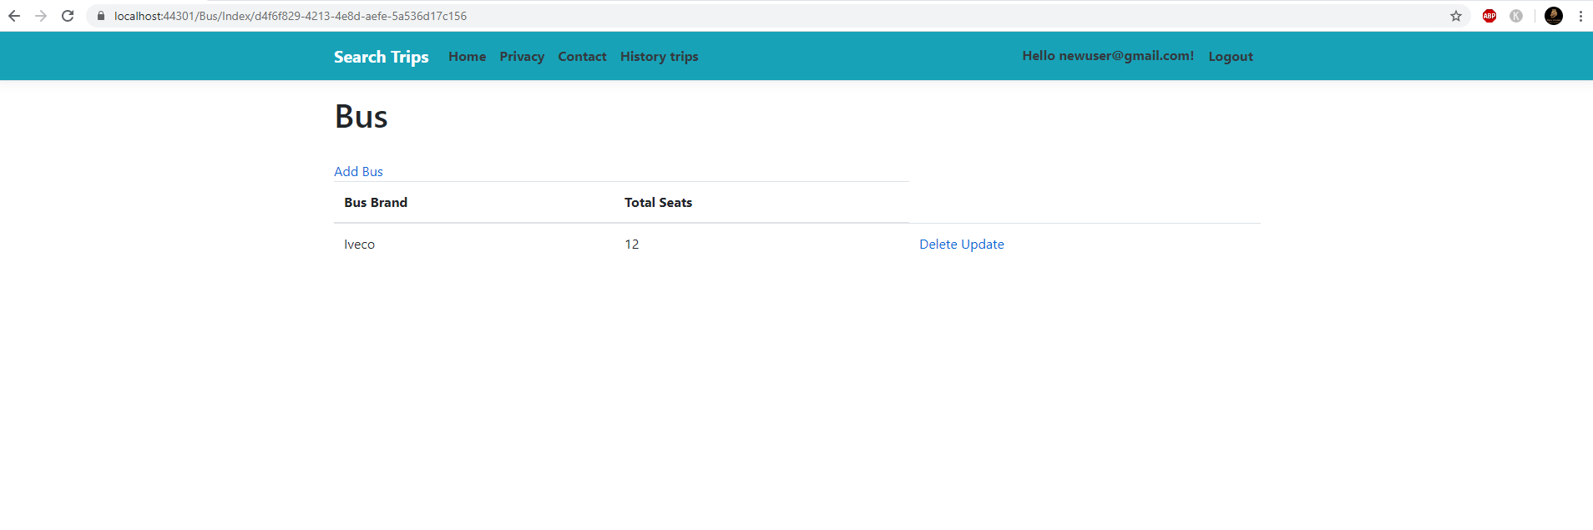
Otherwise it will be displayed the bus info on the specified route

Slide 22
Book seat page
The user can book a seat to the specified trip by clicking the Book Seat button

Slide 23
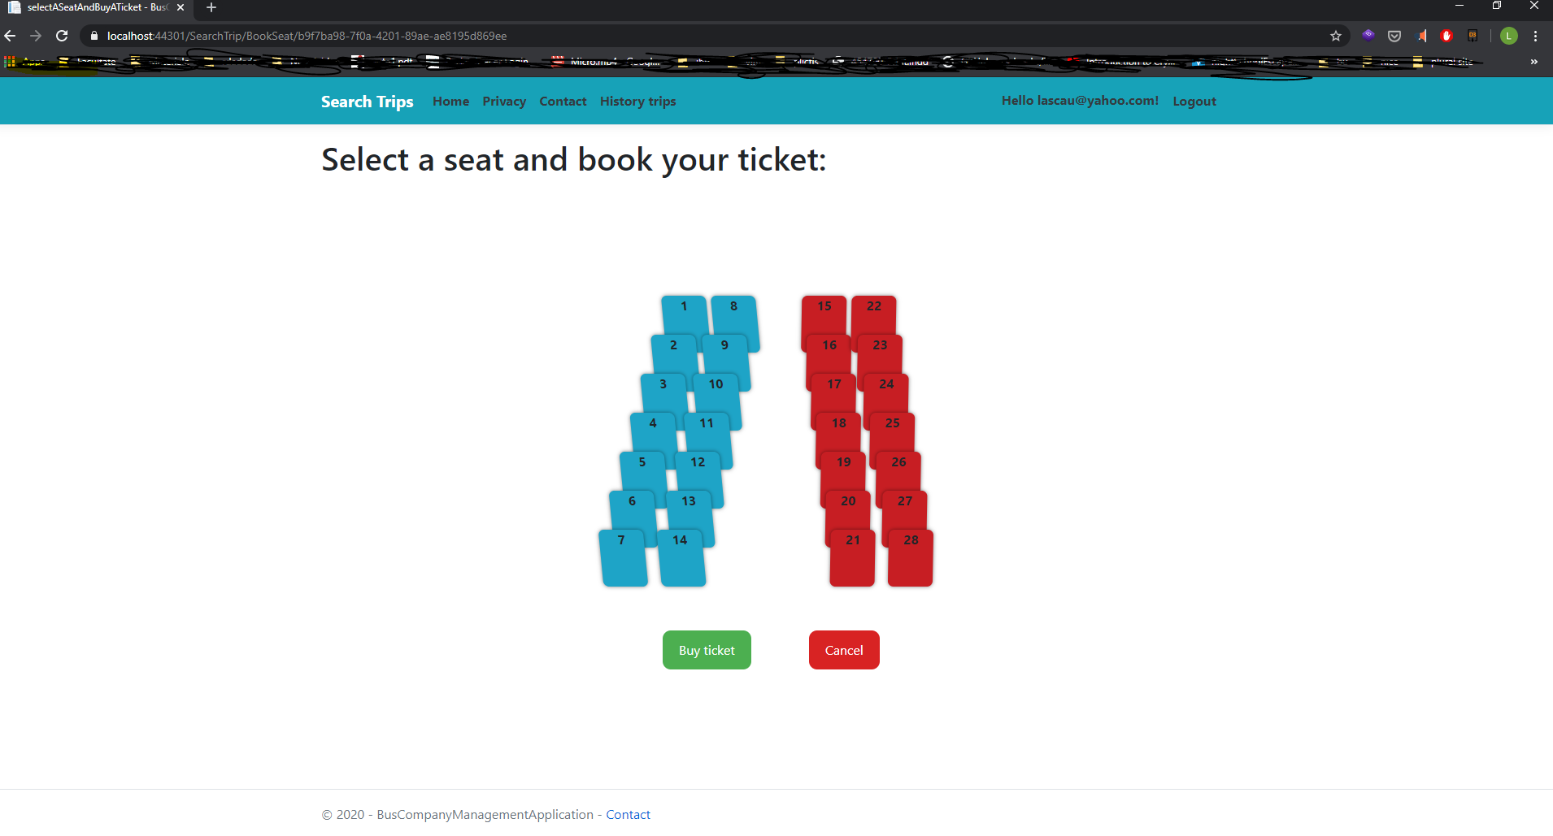
SEATS layout
This will appear after clicking Book seat button

Slide 24
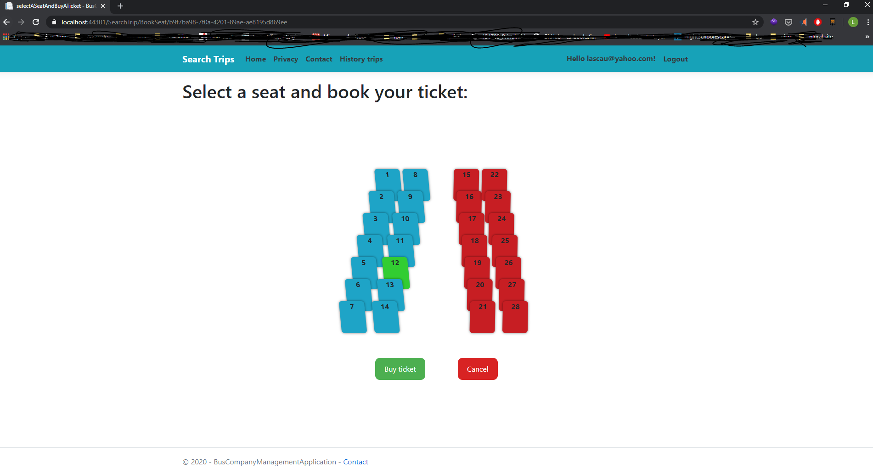
Available seats will be displayed in blue
Reserved seats will be red
Selected seat will be displayed with green
The user must click on the Buy Ticket button to confirm the reservation

Slide 25
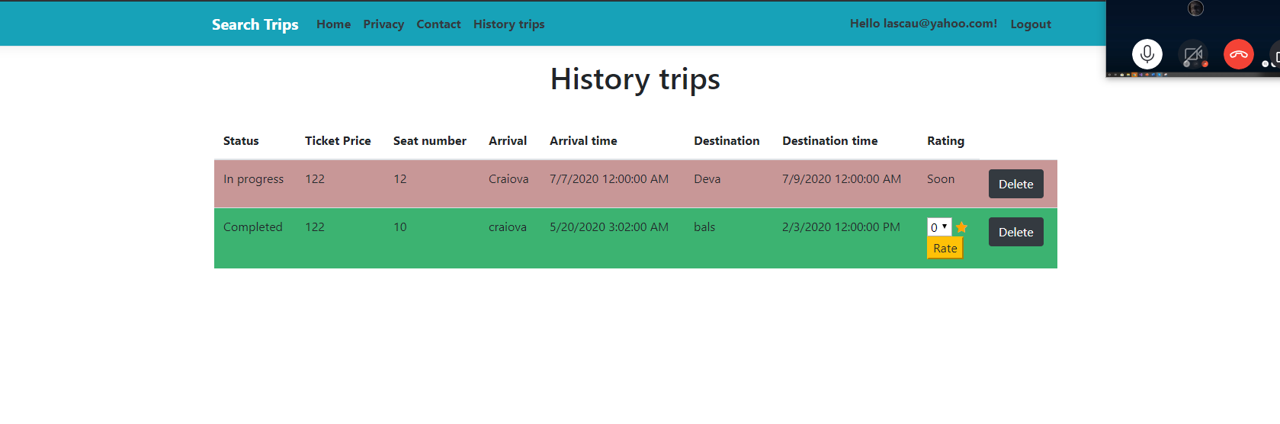
Selected seat will be displayed with green
- The trip is added to the History trips page and the progress can be tracked from here
- The entry will appear with red if the trip is still in progress (Destination time is less then the actual date/time)
The entry will be green if the trip was done (Destination time is greater or equal to the actual date/time), and also the user can add a rating to completed trips
The user can delete anytime an entry from the history trips page

Slide 26
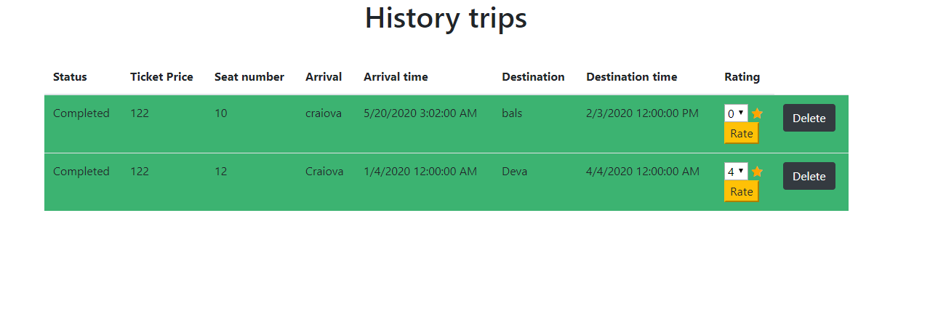
After completing a trip the rate can be added by selecting a value from 0 – 5 in the dropmenu, and then click the “Rate” button to submit to the database

Slide 27
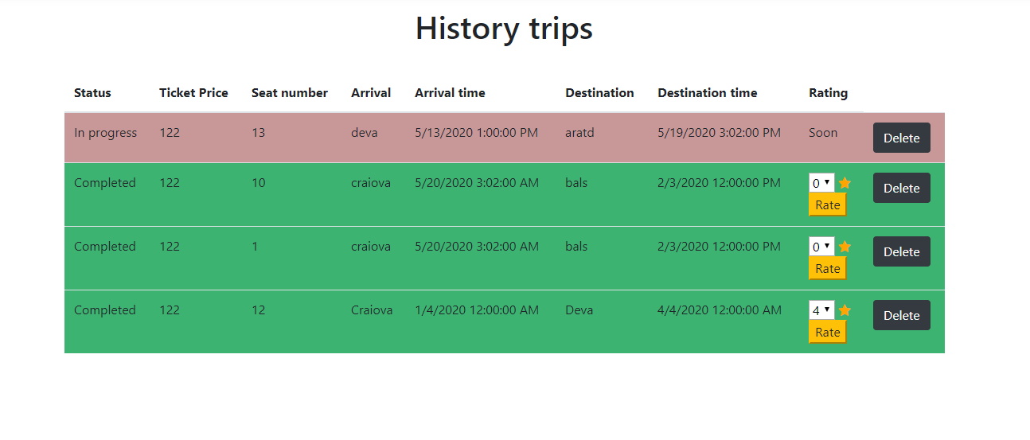
- All the completed trips are displayed in decreasing order by Arrival Time
- All trips in progress are displayed in increasing order by Arrival Time

Slide 28
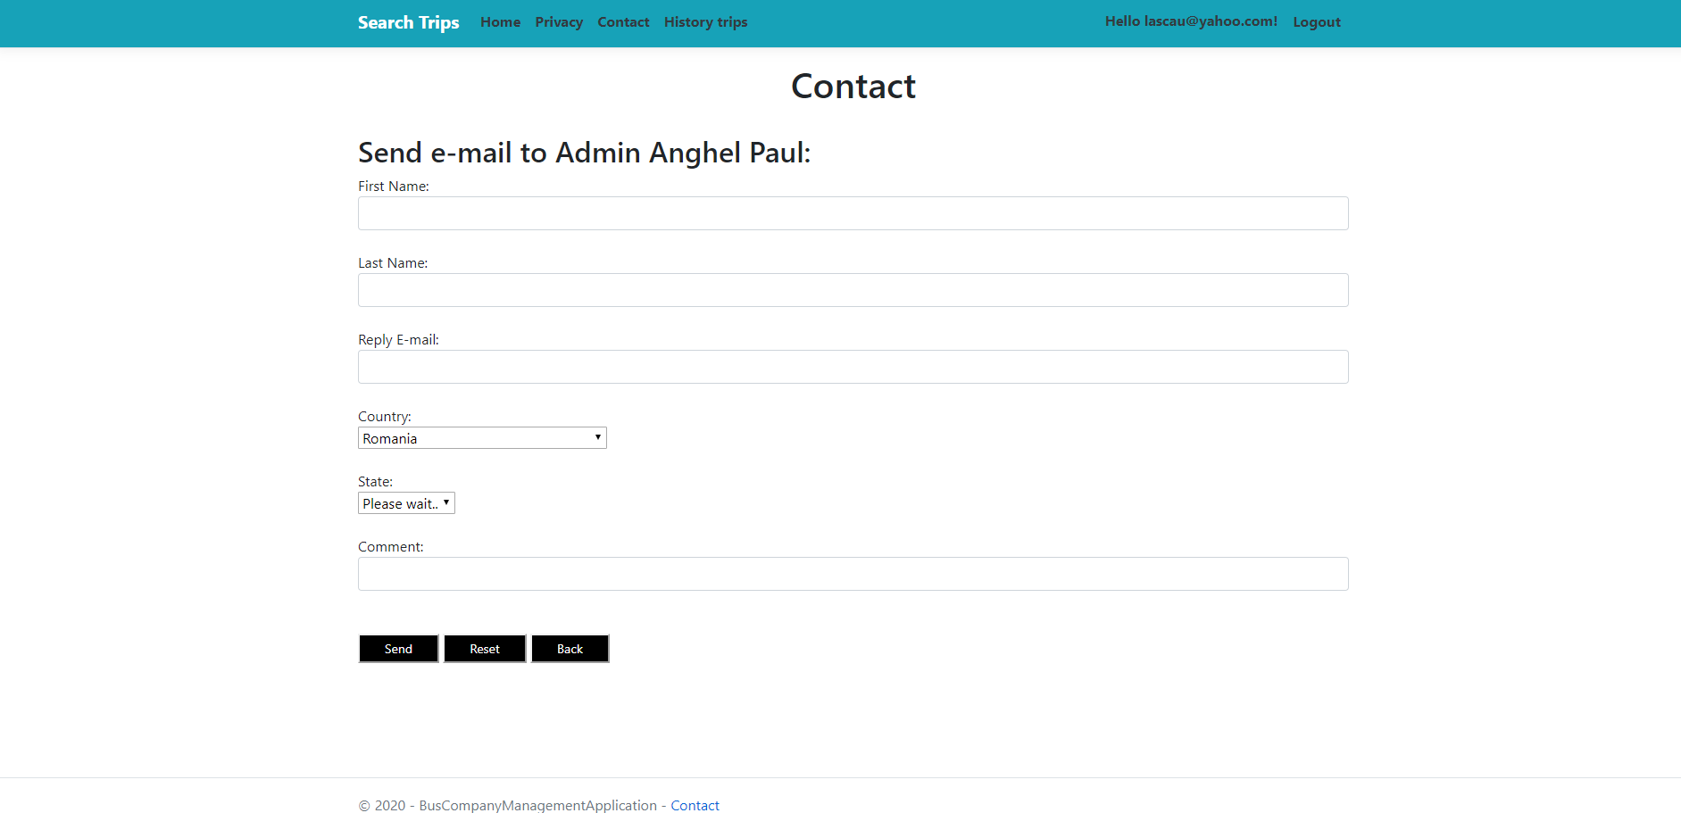
The user can also contact the admin through the contact page.

Slide 29
What a user can’t do?
-He hasn’t rights to access the following pages:
Add Trip - Add trip button
Update Trip - Update button
Delete Trip – Delete button

Slide 31
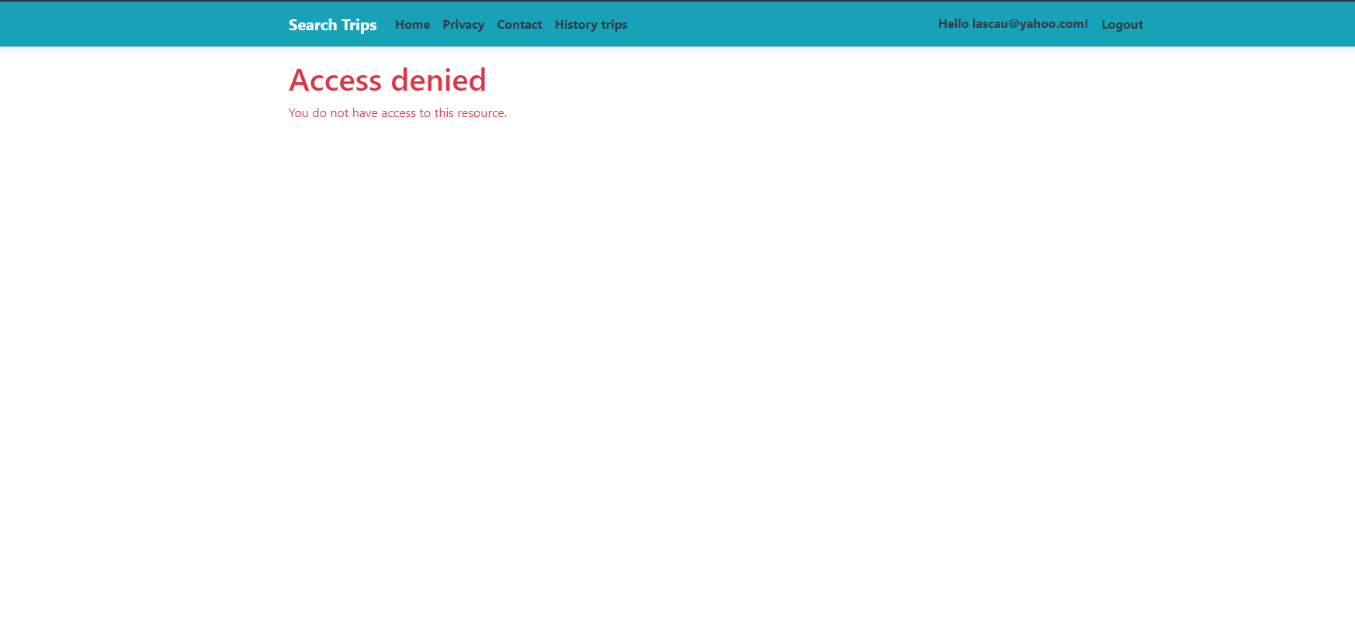
A proper message will be displayed if the user try to access forbidden pages or actions

Slide 32
Administrator
The administrator mainly has access to the CRUD operations in the Search Trip, Bus, History Trip and Announcements pages.
Also, the administrator cannot access history trip, via the web browser, since he has no past trips, it can only be accessed by a user which is present in the database.
The admin can also do basic operations like the user and guest such as searching for trips and viewing announcements on the homepage.

Slide 33
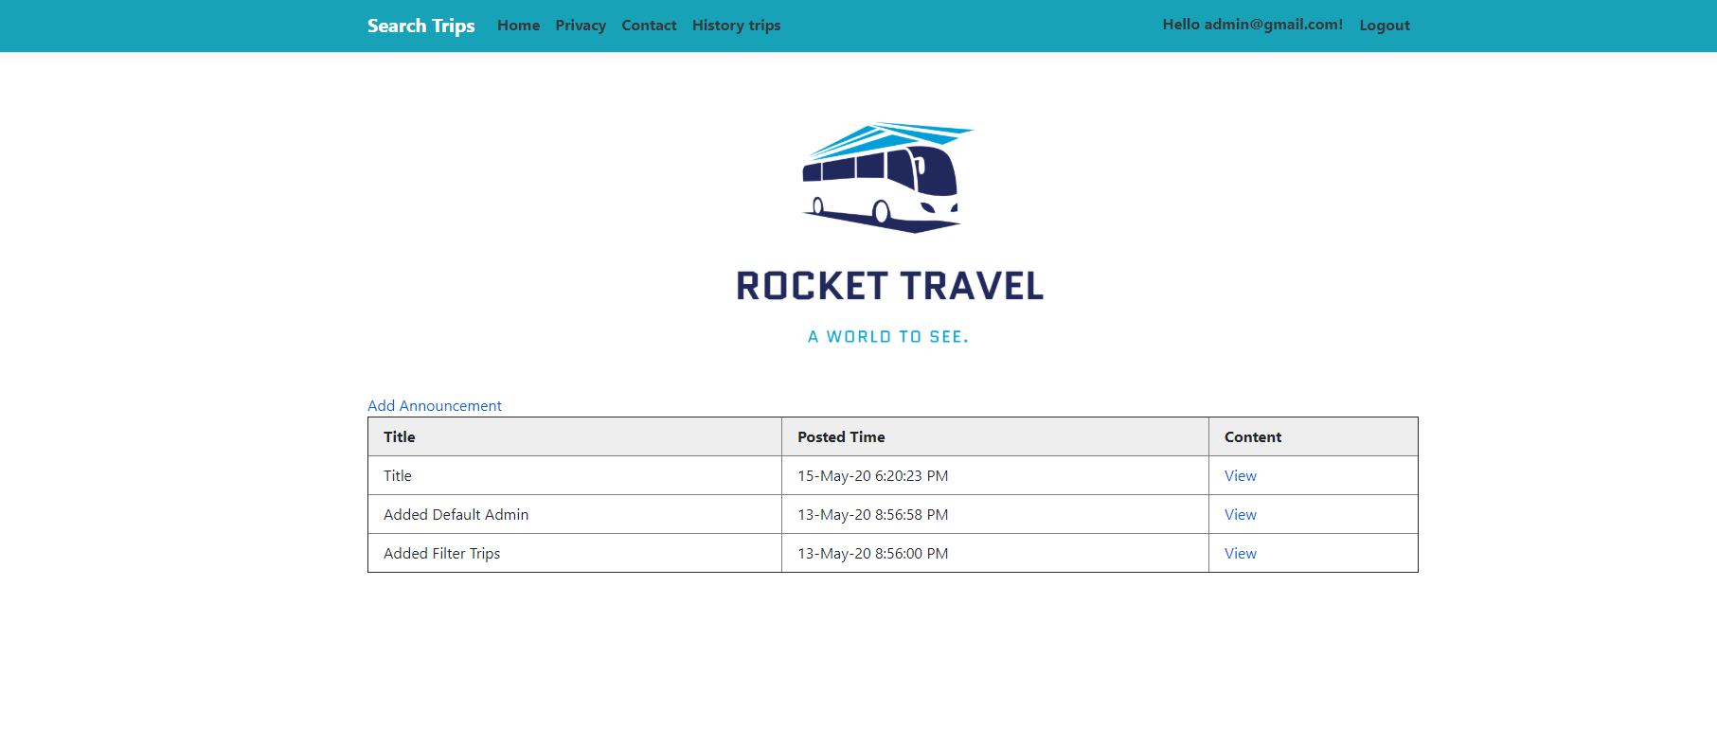
Admin – HOME PAGE
The admin can add new announcements via the “Add announcement” button.
He can also view the content of the announcement by clicking the view button.

Slide 34
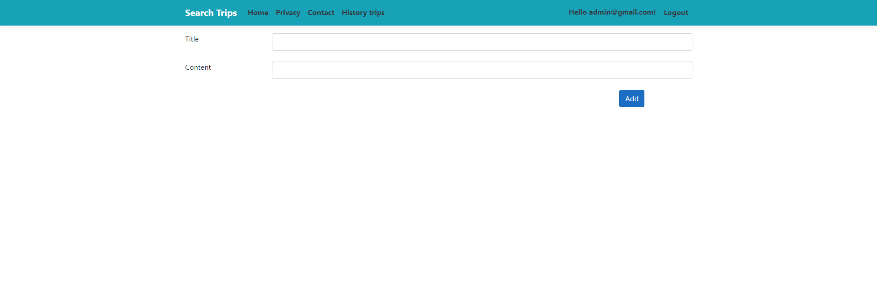
- The admin will be redirected to a simple form to input the data about the announcement.
- Once created, the correct value for posted time will be added to the announcements table, specifying the current date and time.
- Also the admin will be automatically redirected to the home page, where the announcements will be in order from the most recent to the oldest.

Slide 35
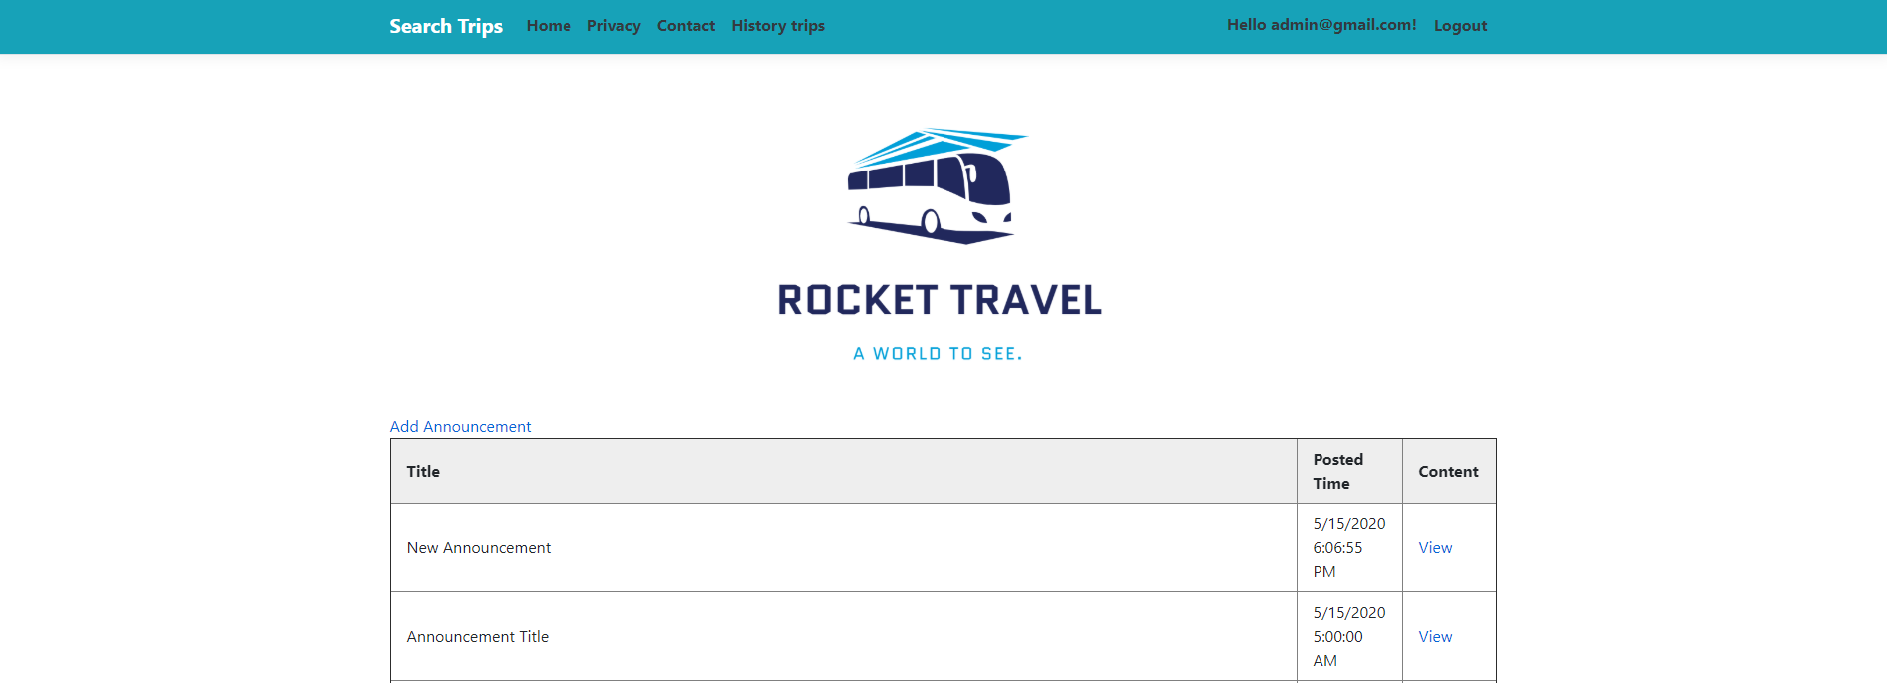
The newly added announcement, shown at the top of the table, also the with the time it was added.

Slide 36
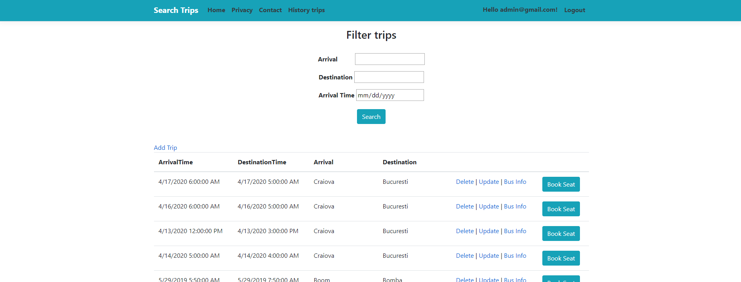
The buttons corresponding to the CRUD operations can be seen above : Add, Delete and Update.

Slide 37
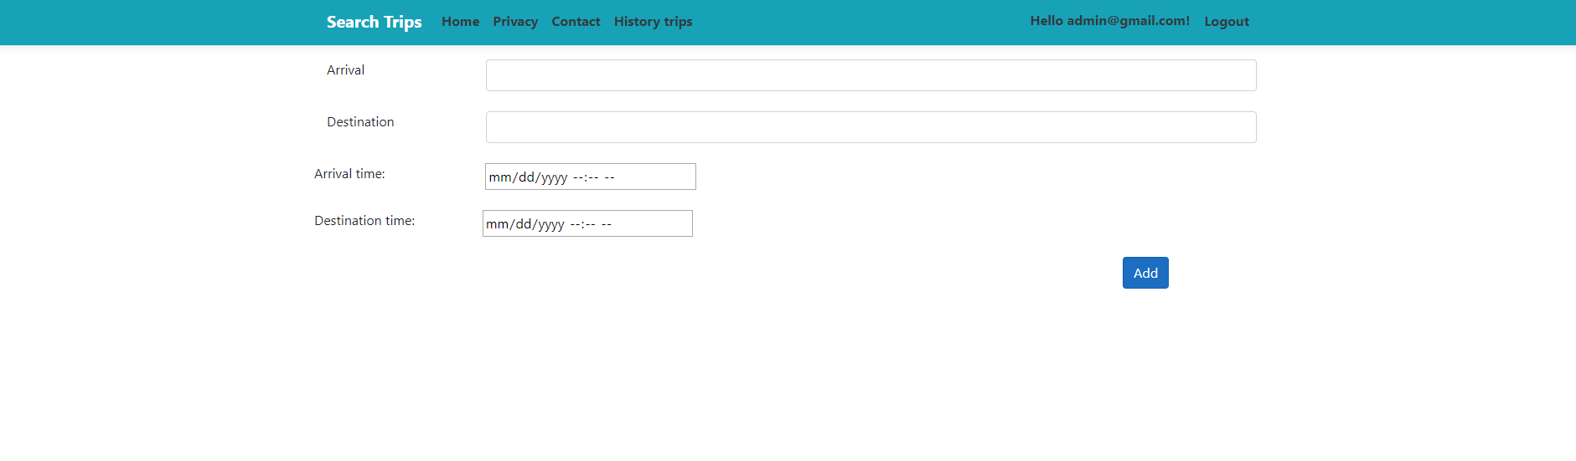
Admin – add trip
- The admin will be prompted for the fields Arrival, Destination, Arrival Time and Destination Time for the buses.
- After pushing the add button the new trip will be added to the database and the admin will be redirected to the search trips page where the new trip will be shown.

Slide 38
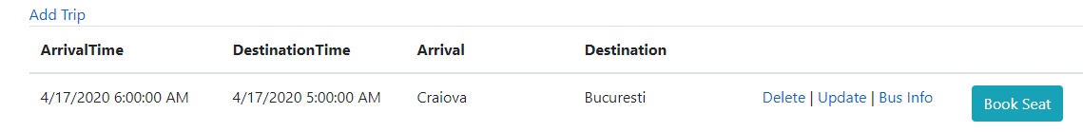
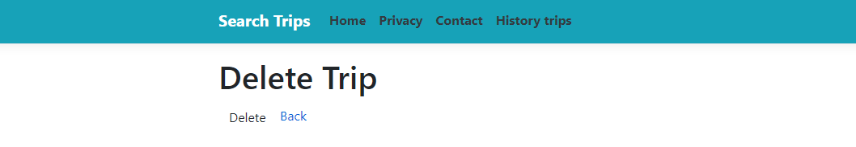
delete trip
When the admin clicks on the delete button he will be redirected to a page which asks if the admin wants to delete it. After the admin will be redirected to the search trips page.

Slide 39
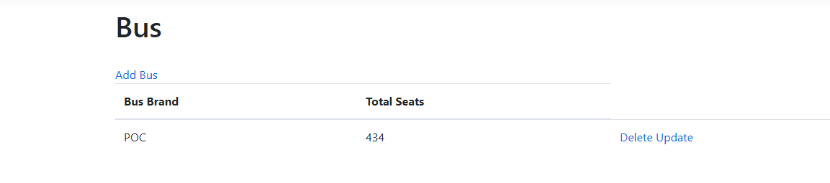
Bus info
The admin will be redirected to the bus controller, where he can add a bus for the specific trip, delete it or update the information about it.

Slide 40
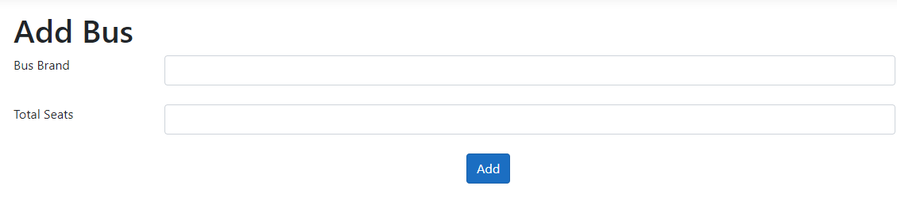
bus info – add bus
After clicking the add bus, the admin will be prompted to insert the bus information. After clicking add he will be redirected to the search trips page.

Slide 41
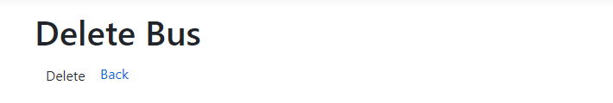
bus info - delete
After clicking delete the admin will be prompted to delete the bus for that specific trip. Afterwards he will be redirected to the main page.

Slide 42
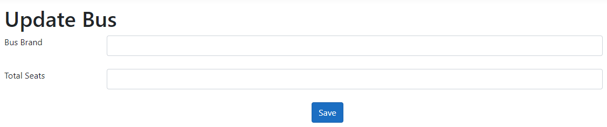
bus info - Update
After clicking the update button the admin will be prompted to insert the new information for the bus.

Slide 43
search trips page
When trying to book a seat, the admin will be redirected to the book a seat page, showing all the available chairs.

Slide 44
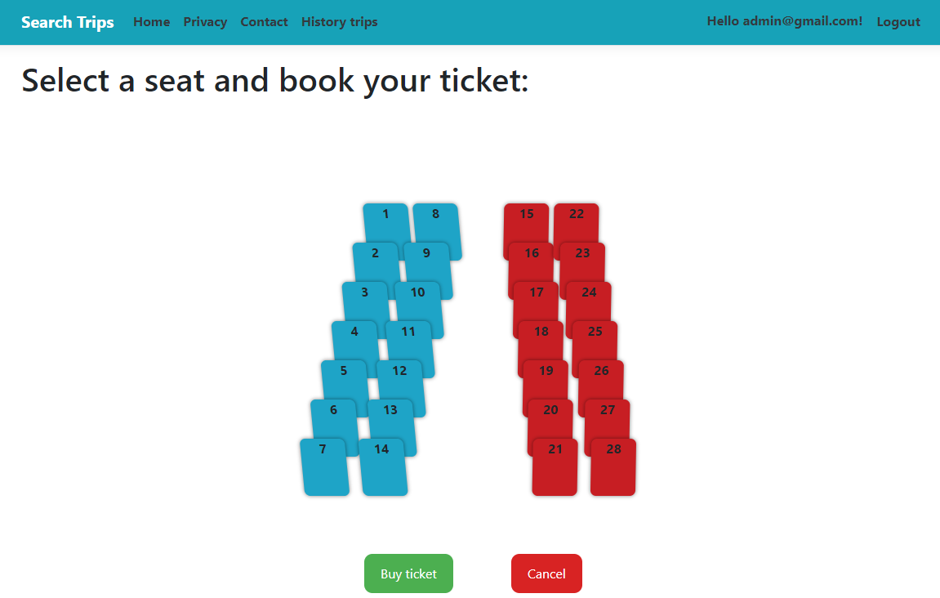
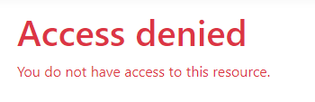
search trips page – BOOK A seat
After clicking on buy ticket, the access will be denied, that operation is only accessible to registered users.

Slide 45
Conclusion
The application works great and it was fun and also challenging to implement this project.
We managed to work as a team and divide the work efficient.
We believe this project helped us understand the workflow from real software engineering teams, and it has helped us gain a great deal of knowledge about ASP .NET CORE, the repository pattern, building design patterns and over all the power of version control systems (Git, Bitbucket).

